Slide 1









Idea submission

Slide 2


Team details
Team Lead: Name: Samanvita S
Contact: 7676406768
Email:
samanvitas.ad24@bmsce.ac.in
Team Member 2: Name: Sanchana
Contact: 938085193
Email: sanchanats.cs24@bmsce.ac.in
Team Member 3: Name: Arya Kulkarni
Contact: 94808 59788
Email:aryakulkarni.ec24@bmsce.ac.in

Slide 3


Our solution
Smart Budgeting & Expense Tracking – AI-based budgeting with UPI-linked auto-tracking and manual cash entry.
Predictive Analytics – AI forecasts expenses and alerts for overspending.
Expense Review Before Logging – Users confirm expenses before finalizing.
Pocket & Savings Management – Separates daily spending money and savings (digital piggy bank).
Interest-Based Savings Options – Users choose between fixed or flexible interest plans.
Freelancing Opportunities – AI suggests freelance gigs based on skills.
Joint Savings for Group Trips – Friends can pool money for shared expenses.
AI-Powered Monthly Review – Analyzes spending and suggests cost-cutting.

Slide 4

TECHNICAL APPROACH
Frontend (User Interface Development)
React / Flutter – For web and mobile app development
Tailwind CSS / Material UI – For UI styling
Backend (Server & API Development)
Node.js / Django / FastAPI – For handling logic & APIs
Database (Storage & Transactions)
PostgreSQL / MySQL / MongoDB – For storing financial data
AI/ML (Smart Finance Analysis)
Python – For AI models
Payment & UPI Integration(NOT USED)
UPI API / Payment Gateway SDKs – For transaction tracking
Deployment & DevOps
Docker / Kubernetes – For scalable deployment
CI/CD tools (GitHub Actions, Jenkins) – For automated updates

Slide 5
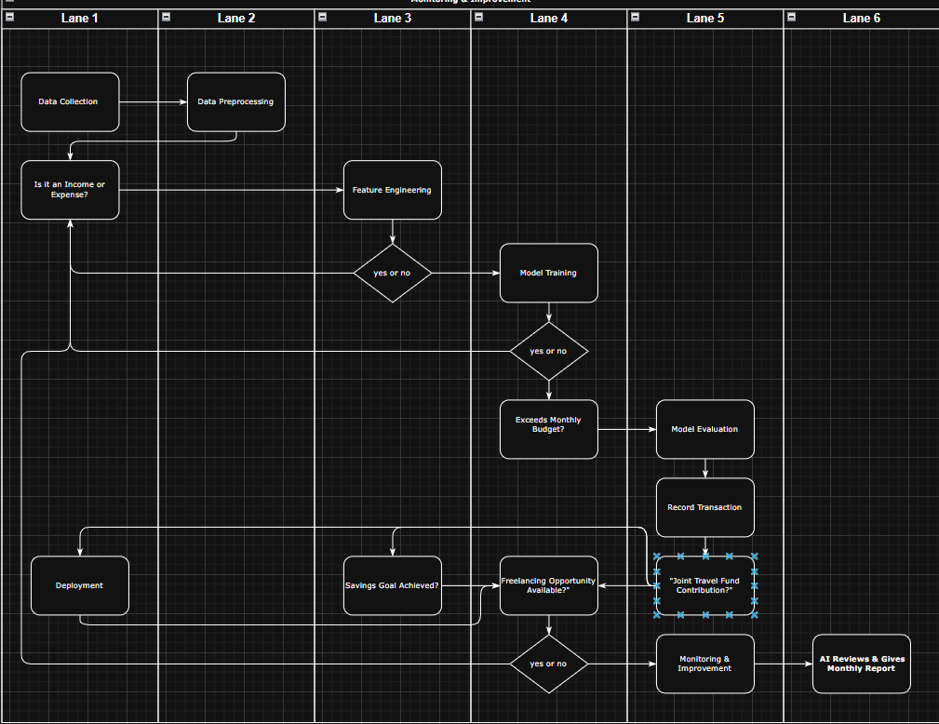
Workflow/pipeline
AI Finance Management System
Data Collection – Gather financial data from UPI transactions, manual entries, and bank APIs.
Data Preprocessing – Clean and categorize expenses, detect anomalies, and normalize data.
Feature Engineering – Extract spending patterns, savings habits, and freelancing trends.
Model Training – Train AI on budgeting, expense prediction, and fraud detection.
Model Evaluation – Optimize accuracy using historical transaction data.
Deployment – Integrate with a finance app, offering real-time insights via API.
Monitoring & Improvement – Track spending patterns, detect fraud, and refine AI recommendations.

Slide 6
Feasibility & FUTURE SCOPE
PROS
Smart Budgeting – Personalized financial planning helps students manage expenses effectively.
Encourages Savings – Digital piggy bank and interest-based savings promote financial discipline.
Freelancing Support – Helps students earn through AI-suggested job opportunities.
Group Savings Feature – Joint accounts simplify trip planning and shared expenses.
AI-Powered Insights – Monthly reviews help students cut unnecessary expenses.
Secure Transactions – Encrypted data ensures privacy and financial security.
CONS
Dependency on UPI & Digital Payments – Cash-based transactions require manual entry, reducing automation.
AI Prediction Limitations – Budget suggestions may not always align with real-life fluctuations.
Privacy Concerns – Users may hesitate to link financial data due to security risks.
Technical Challenges – Requires strong AI and banking integration, which can be complex.
Limited Freelancing Market – The success of freelancing suggestions depends on demand and user skills.

Slide 7
Feasibility & FUTURE SCOPE
Future Scope of the Project
The project can evolve with AI-based investment guidance, automated bill payments, and gamified savings to enhance financial discipline. Voice chatbots will offer instant assistance, while cross-border transactions will support international students. An AI-driven freelance marketplace will connect students with job opportunities, and fraud detection will ensure secure transactions, making financial management smarter and safer.

